Slide 1


Integrated AI-Based Personal Behaviour Analysis and Self-Improvement System
Transforming behavioral data into actionable self-improvement insights.
by Pravin Choudhary

Slide 2
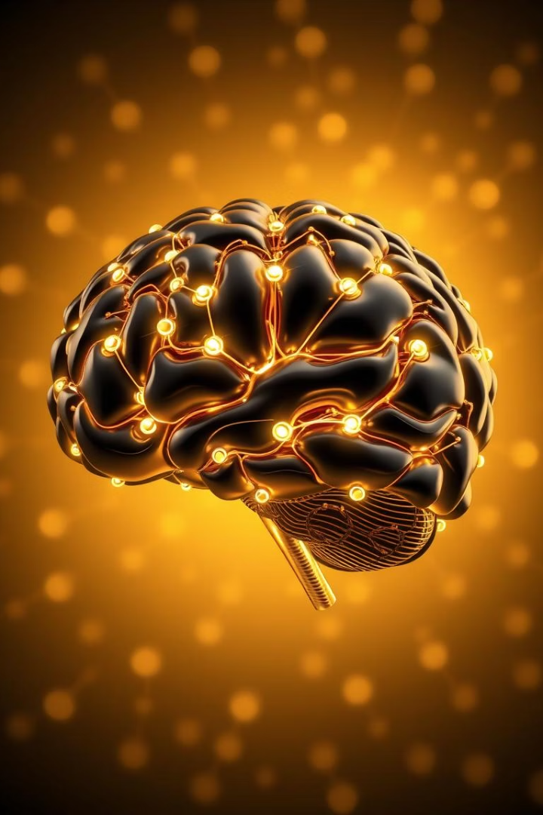
Presentation Overview
Purpose & Scope
Actionable self-improvement insights.
Problem Addressed
Fragmented data and lack of personalization.
Objectives
Enhance self-awareness and personalized plans.

Slide 3
Purpose & Scope
Transform everyday behavioural data into actionable insights.
Continuously monitor user habits using AI/ML.
Optimize health, productivity, and well-being.
Sleep
Meals
Activity
Time Use

Slide 4
Problems Addressed
Fragmented Data
Lack of Personalization
Insufficient Insight
Isolated habit trackers fail to integrate sources.
Generic advice not tailored to individual patterns.
Hard to see how habits impact long-term goals.

Slide 5




Objectives
Enhance Self-Awareness
Holistic profile from multimodal data.
Personalized Recommendations
Real-time ML-driven action plans.
Sustainable Change
Interactive goal setting + feedback.

Slide 6





System Components
Data Collection
AI Analysis
Report Generation
Goal Setting

Slide 7

Novelty
Aspect
Existing Gap
Novelty
Data Integration
Isolated metrics
Holistic data fusion
Adaptability
Static advice
Adaptive ML
Feedback Loop
Delayed feedback
Real-time alerts

Slide 8

Unique Attributes
Adaptive Personalization
Learning from user feedback.
Interactive Engagement
Dashboard + goal-setting UI.
Privacy & Security
Encryption, anonymization.

Slide 9

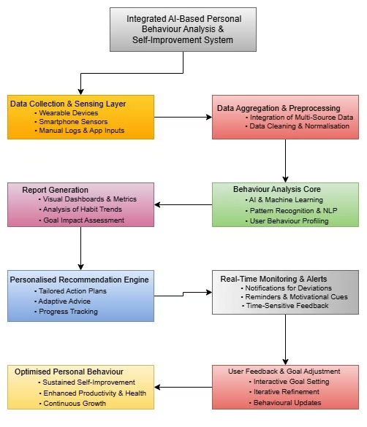
Process Workflow
1
Data Ingestion
2
Preprocessing
3
Storage
4
Analysis

Slide 10
Results & Advantages
Higher Self-Awareness
Personalized Feedback
Real-Time Monitoring
Sustainable Change

